Slide 1
All Anew: Bible Study #2
Presenter Kelly Fryer

Slide 2
“I tell you, something greater than the temple is here.” – Mat 12:6
Remember, this is God’s gig – and let that set you free.

Slide 3
Don’t you dare disengage.
1
“…be subject to the governing authorities, for there is no authority except from God.” - Romans 13

Slide 4
Pay your taxes. Be a good citizen. Respect & honor those in authority when it is due. Hold your leaders accountable. - Romans 13
All authority comes from God (13:1)
What is holy & acceptable to God?
Government is God's servant (13:6)
Be humble & sober (12:3)
Use gifts for good of community (12:6-8)
Give to those in need (12:13)
Live in harmony (12:16)
Leave vengeance to the Lord (12:19)
Welcome those who are different (14:1-6)
Make peace (14:19)
Don’t impose your religion on others (14:1-16)
All those under God’s authority – including government – are expected to:

Slide 5
What can I do?
Get informed at BolderAdvocacy.org
Form an advocacy committee
Partner with nonpartisan groups like League of Women Voters, YWCA and host issue forums & candidate forums
Register to vote and vote, in every election, in every single race
Focus on the ISSUES and become a source of knowledge for your network

Slide 6
Get woke.
2
“…you know what time it is, how it is now the moment for you to wake up from sleep. For salvation is nearer to you than when we became believers; the night is far gone and the day is near.” - Romans 13:11-12

Slide 7
Here is a terrible fact: Nobody sleeps better than white people.
That ought to wake us up.

Slide 8
What can I do?
Don’t ask your friends of color to do it for you. Use google.
Start a Movie Club: Good Hair, Moonlight, 13th, I Am Not Your Negro, Hidden Figures, Loving
Start a Book Club: Waking Up White, The Fire Next Time, Between the World & Me, The Immortal Life of Henrietta Lacks, The New Jim Crow
Find a YWCA that has anti-racism programs or a SURJ group to join, or an online class you can take

Slide 9
Decide right now to be good, rather than nice.
3
“Let no one’s heart fail because of [the giant]; your servant will go and fight with him.” – 1 Samuel 17

Slide 10
What’s the difference?
Nice
Good
Avoids controversy & runs from conflict
“That’s OK,” even when it’s not
Doesn’t risk upsetting the status quo
Worries about “what the neighbors think”
Let’s you run all over her
Does what matters.
Knows there are more important things than your reputation or wallet
Loves EVERYONE - and will stand with those who are being putting down or hurt
Speak up even when she’s scared for what is right

Slide 11
I’m talking to you, my white sisters.
We all have a lot of work to do.

Slide 12
What can I do?
Find a “good buddy” – practice on and support each other, and hold each other accountable
Make your church a “No Niceness Zone”
Call people in when they say/do things out of ignorance – call out microagressions every single time
Tell your pastor that you’ll have her/his back if she/he leaves nice behind for good, too.

Slide 13
Maybe start here.

Slide 14
Always take the side of those who have been sidelined.
4
“Just as you did it to one of the least of these who are members of my family, you did it to me.” - Matthew 25

Slide 15
This is where God can always be found.
“Since there will never cease to be some in need on the earth, I therefore command you, ‘Open your hand to the poor and needy neighbor in your land’” (Deuteronomy 15:11).
“Whoever is kind to the poor lends to the Lord, and will be repaid in full” (Proverbs 19:17).
“Give to everyone who begs from you, and do not refuse anyone who wants to borrow from you” (Matthew 5:42).
“Sell your possessions, and give [to the poor]” (Luke 12:33b).
“As for those who in the present age are rich, command them…to do good, to be rich in good works, generous, and ready to share…” (1 Timothy 6:17–18).

Slide 16
What can I do?
Listen • Honor • Respect • Learn
Ask your friends holy troublemaking questions like:
Have we ever asked the folks who come to our food bank what they really need? Or what they have to offer, or share with others?
I’ve noticed that the lines have gotten longer since our state cut services. What can we do about that?

Slide 17
Amplify the voices that have not been heard – those are the folks through whom God most often speaks.
5
“The word of the Lord that came to Micah of Moresheth…” - Micah 1

Slide 18
When you’re with people of color, talk less and listen more. When you’re with white people, SPEAK UP.
A good rule of thumb.

Slide 19
What can I do?
Find out who in your community is already doing justice work – go ask how you can help
Use your privilege to make space for others – ask “why aren’t there any young people on this committee?”, “how about letting someone new do…?”, “don’t you think we need a different perspective?”

Slide 20
Never forget who you are.
6
“Paul, a prisoner of Christ Jesus, and Timothy our dear brother. To Philemon, our dear friend and co-worker, to Apphia our sister, to Archippus our fellow soldier, and to the church in your house.” - Philemon 1:1-3

Slide 21
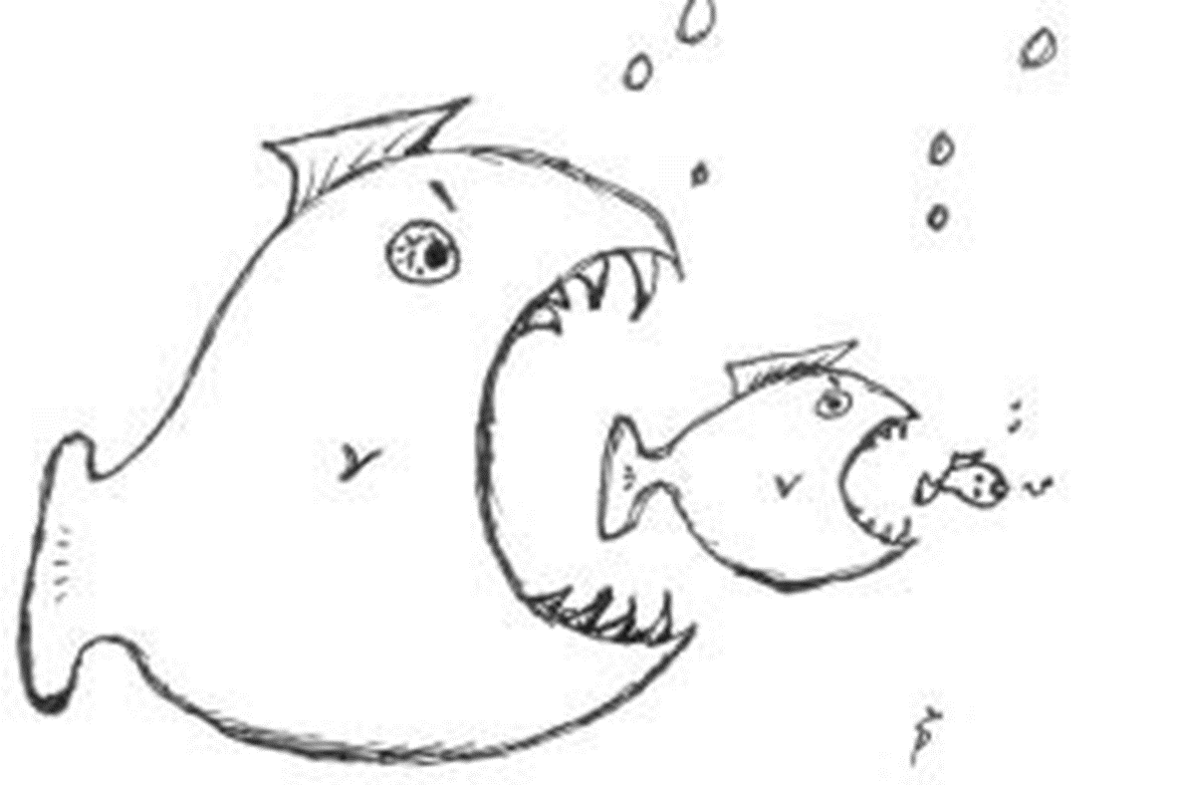
No wonder everyone’s so afraid.

Slide 22
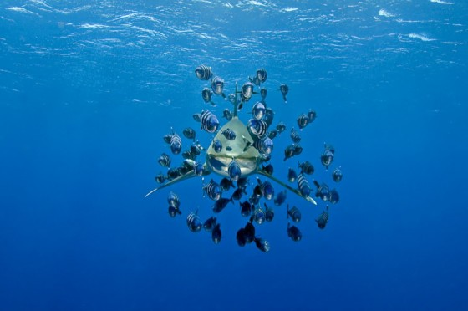
But this is the world God actually made.

Slide 23
What can I do?
Tally up what you have to lose and ask, “What’s the worst that can happen?”
Go for a walk in a cemetery and think about what you want to be remembered for
Look for new friends, collaborators, co-conspirators --- especially those who are taking action, on the front lines, who can help you feel brave

Slide 24
Some things to think about:
Where are you being called to stir up trouble, as part of God’s mission to love, save and bless the world?
Are you ready? If not, who can you ask for help and support?
How can you help and support your fellow troublemakers back home?

